Slide 1
Super Store Sales Report
(Python- SQL Project)
BY SARANSH GOYAL

Slide 2
Basic Problem
List all unique cities where customers are located.
Count the number of orders placed in 2017.
Find the Total sales per category.
Calculate the percentage of orders that were paid in installments.
Count the number of customers from each state

Slide 3
Intermediate Problem
Calculate the number of orders per month in 2018.
Find the average number of products per order, grouped by customer city.
Calculate the percentage of total revenue contributed by each product category.
Identify the correlation between product price and the number of times a product has been purchased.
Calculate the total revenue generated by each seller, and rank them by revenue.

Slide 4
Advanced Problem
Calculate the moving average of order values for each customer over their order history.
Calculate the cumulative sales per month for each year.
Calculate the year-over-year growth rate of total sales.
Calculate the retention rate of customers, defined as the percentage of customers who make another purchase within 6 months of their first purchase.
Identify the top 3 customers who spent the most money in each year.

Slide 5
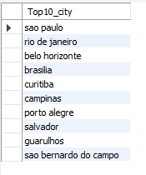
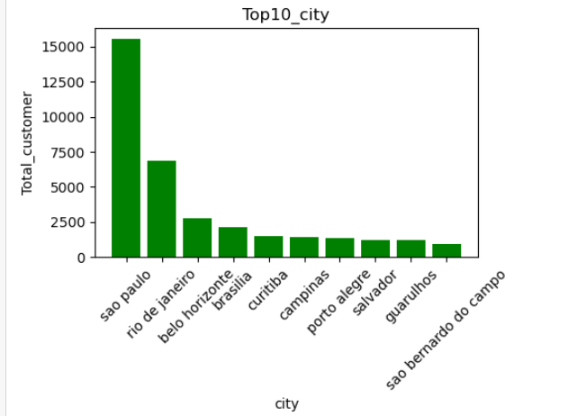
Basic Problem
Ques-
List all unique cities where customers are located.
SELECT
customer_city as Top10_city
FROM customers
group by customer_city
order by count(customer_city) desc limit 10
x=top10_city['index']
y=top10_city['total_customers']
plt.figure(figsize=(5,3))
plt.bar(x,y,color='g')
plt.title('Top10_city')
plt.xlabel('city')
plt.ylabel('Total_customer')
plt.xticks(rotation=45)
plt.show()

Slide 6


Basic Problem
Ques-
Count the number of orders placed in 2017.
SELECT
COUNT(order_id) as Orders_2017
FROM orders_table
WHERE YEAR(order_purchase_date) = '2017'
m1=orders['order_purchase_date'].dt.year==2017
orders[m1]['order_id'].count()

Slide 7
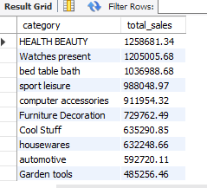
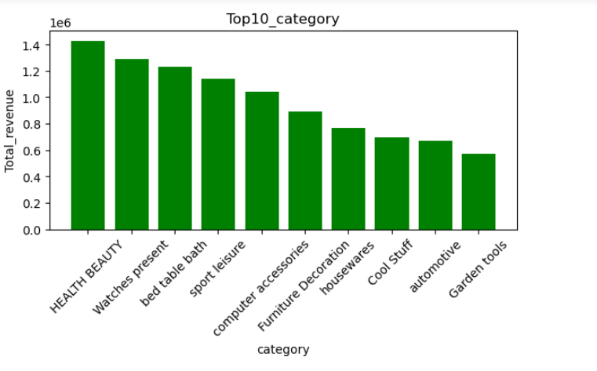
Basic Problem
Ques-
Find the Total sales per category.
SELECT p.product_category AS category, ROUND(SUM(oi.price), 2) AS total_sales FROM order_item oi JOIN products p ON oi.product_id = p.product_id GROUP BY p.product_category ORDER BY total_sales DESC LIMIT 10;
x1=top10_category['product_category']
y1=top10_category['category_rev']
plt.figure(figsize=(7,3))
plt.bar(x1,y1,color='g',width=0.8, edgecolor="white", linewidth=0.7)
plt.title('Top10_category')
plt.xlabel('category')
plt.ylabel('Total_revenue')
plt.xticks(rotation=45)
plt.show()
'

Slide 8
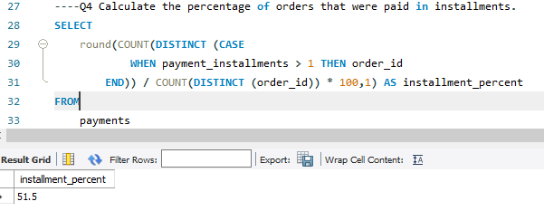
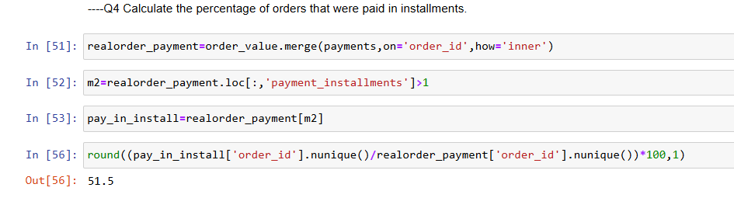
Basic Problem
Ques-
Calculate the percentage of orders that were paid in installments.

Slide 9
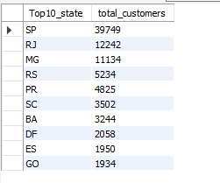
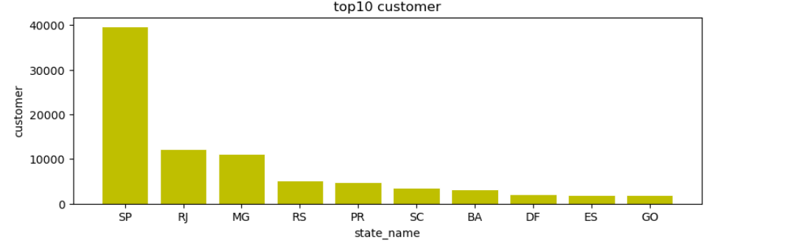
Basic Problem
Ques-
Count the number of customers from each state
SELECT customer_state AS Top10_state, COUNT(distinct customer_unique_id) AS total_customersFROM customers c join orders ot on c.customer_id=ot.customer_id where ot.order_status not in ('Canceled','Unavailable')GROUP BY customer_state order by total_customers desc limit 10
x2=top10_state['customer_state']
y2=top10_state['total_customers']
plt.figure(figsize=(10,3))
plt.bar(x2,y2,color='y',width=0.8, edgecolor="white",linewidth=0.7)
plt.title('top10 customer')
plt.xlabel('state_name')
plt.ylabel('customer')
plt.show()

Slide 10
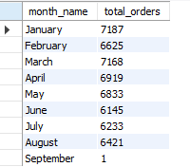
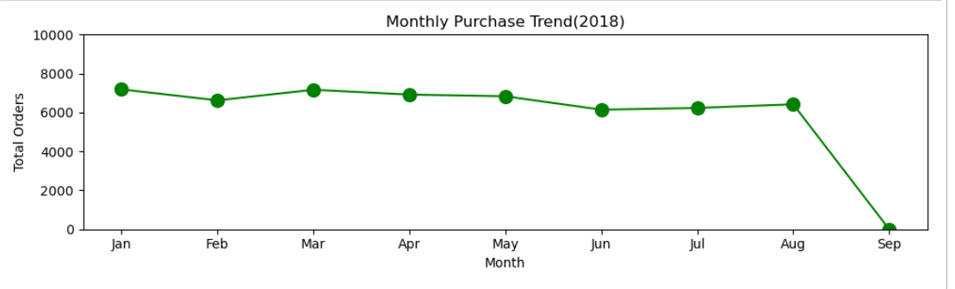
Intermediate Problem
Ques-
Calculate the number of orders per month in 2018.
SELECT
MONTHNAME(order_purchase_date) AS month_name, COUNT(DISTINCT (order_id)) AS total_orders
FROM orders_table where year(order_purchase_date)=2018 and order_status not in ('Canceled','Unavailable’)
GROUP BY month_name , MONTH(order_purchase_date)
ORDER BY MONTH(order_purchase_date)
x3=per_month_orders['Month']
y3=per_month_orders['Total_orders_2018']
plt.figure(figsize=(10,3))
plt.plot(x3,y3,color='g',marker='o',markersize=10)
plt.ylim(0,10000)
plt.title('Monthly Purchase Trend(2018)')
plt.xlabel('Month')
plt.ylabel('Total Orders')
plt.tick_params(axis='x')
plt.tight_layout()
plt.show()

Slide 11
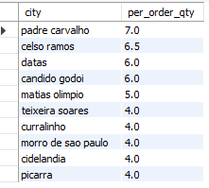
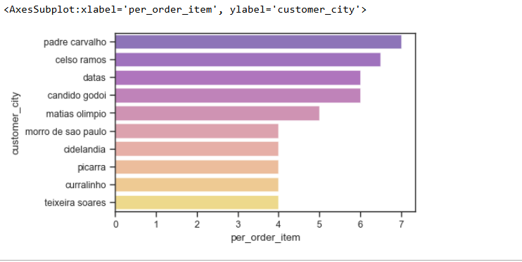
Intermediate Problem
Ques-
Find the average number of products per order, grouped by customer city.
SELECT city, ROUND(AVG(order_qty), 1) AS per_order_qty
FROM (SELECT c.customer_city AS city, oi.order_id, COUNT(oi.product_id) AS order_qty
FROM order_item oi
JOIN orders_table ot ON oi.order_id = ot.order_id
JOIN customers c ON ot.customer_id = c.customer_id
GROUP BY c.customer_city , oi.order_id) AS base1
GROUP BY city
ORDER BY per_order_qty DESC LIMIT 10
plt.figure(figsize=(5,3))
sns.set_style('ticks')
sns.set_context('paper')
sns.barplot(data=top10_city,x='per_order_item',y='customer_city',alpha=0.6,palette='plasma')

Slide 12
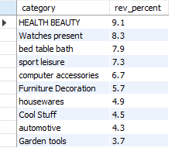
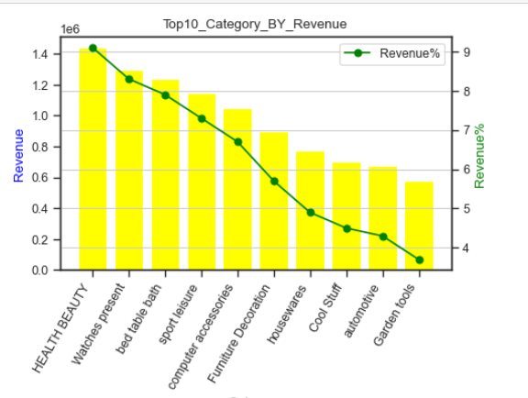
Intermediate Problem
Ques-
Calculate the percentage of total revenue contributed by each product category.
WITH revenue_by_category AS (
SELECT p.product_category, SUM(oi.price) AS rev
FROM order_items oi
JOIN products p ON oi.product_id = p.product_id
GROUP BY p.product_category)
SELECT product_category,
ROUND(rev,2) AS revenue,
ROUND(100 * rev / (SELECT SUM(rev)
FROM revenue_by_category), 2)
AS pct_total_revenueFROM revenue_by_category
ORDER BY rev DESC;
fig, ax1 = plt.subplots(figsize=(5,3))
# First axis (Orders as bar)
ax1.bar(top10_category['product_category'],top10_category['category_revenue'], color='yellow', label='Revenue')
ax1.set_xlabel("Category")
ax1.set_ylabel("Revenue", color='blue')
ax2 = ax1.twinx()
ax2.plot(top10_category['product_category'],top10_category['revenue_percent'], color='green', marker='o', label='Revenue%')
ax2.set_ylabel("Revenue%", color='green')
plt.title("Top10_Category_BY_Revenue")
plt.xticks(rotation=90)
plt.grid(True)
plt.legend(loc='upper right')
plt.setp(ax1.get_xticklabels(),rotation=60,ha='right')
plt.show()’)S

Slide 13
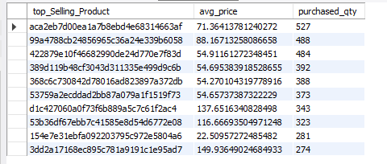
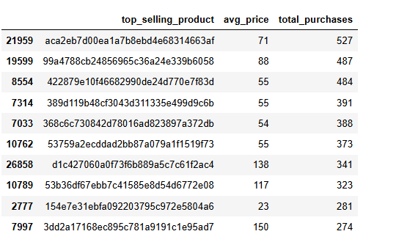
Intermediate Problem
Ques-
Identify the correlation between product price and the number of times a product has been purchased.
SELECT
product_id as top_Selling_Product,
AVG(price) AS avg_price,
COUNT(product_id) AS purchased_qty
FROM order_item
GROUP BY product_id
order by purchased_qty desc limit 10
df=all_real_tables.groupby('product_id').agg(avg_price=('price','mean'),total_purchases=('product_id','count')).reset_index()
df.sort_values('total_purchases',ascending=False).head(10).rename(columns={'product_id':'top_selling_product'})

Slide 14
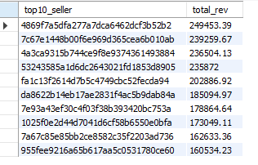
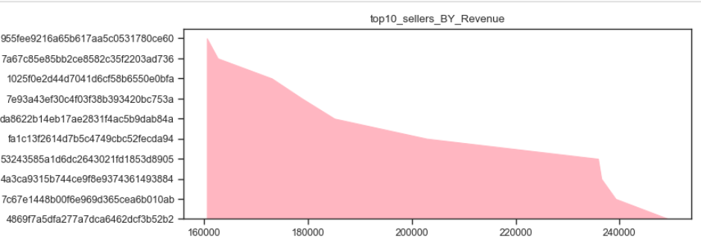
Intermediate Problem
Ques-
Calculate the total revenue generated by each seller, and rank them by revenue.
SELECT seller as top10_seller,
ROUND(SUM(revenue_by_seller), 2) AS total_rev
FROM (SELECT oi.order_id, oi.seller_id AS seller, (oi.price / b.price_value) * ov.total_value AS revenue_by_seller
FROM order_item oi
JOIN order_value ov ON oi.order_id = ov.order_id
JOIN (SELECT order_id,
ROUND(SUM(price), 2) AS price_value
FROM order_item
GROUP BY order_id) AS b ON oi.order_id = b.order_id) AS revenue_generated_by_sellers
GROUP BY seller
ORDER BY total_rev DESC limit 10
plt.figure(figsize=(8,3))
y5=top10_seller['seller_id']
x5=top10_seller['seller_rev']
plt.stackplot(x5,y5,color='lightpink')
plt.title('top10_sellers_BY_Revenue')
plt.show()

Slide 15
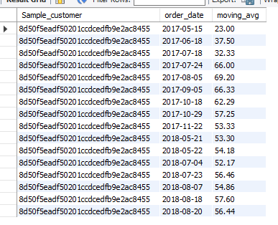
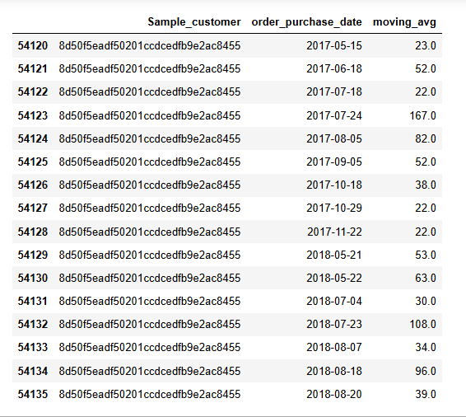
Advanced Problem
Ques-
Calculate the moving average of order values for each customer over their order history.
select order_year,order_month, (sum(sale) over(partition by order_year order by order_year,
order_month ROWS BETWEEN UNBOUNDED PRECEDING AND CURRENT ROW)) as moving_total
from(select year(ot.order_purchase_date) as order_year,
month(ot.order_purchase_date) as order_month,
sum(ov.total_value) as Sale
from orders ot
join order_value ov on ot.order_id=ov.order_id
group by order_year,order_month
order by order_year asc,order_month asc) as base limit 10
order_merge_py_c=orders.merge(order_value,on='order_id',how='inner').merge(customers,on='customer_id',how='inner')y5=top10_seller['seller_id']
moving_avg_per_cust=order_merge_py_c.groupby(['customer_unique_id','order_purchase_date'])['total_value'].rolling(window=16,min_periods=1).mean().reset_index(name='moving_avg
moving_avg_per_cust.sort_values('customer_unique_id').drop(columns='level_2’)
moving_avg_per_cust['customer_unique_id'].value_counts()

Slide 16
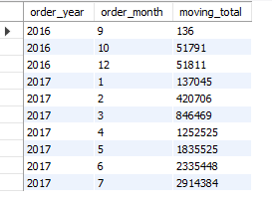
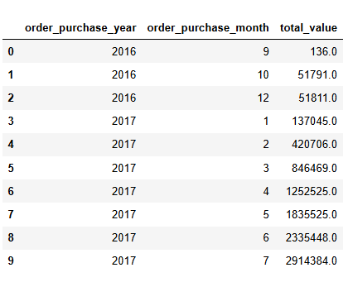
Advanced Problem
Ques-
Calculate the cumulative sales per month for each year.
select order_year,order_month,
(sum(sale) over(partition by order_year
order by order_year,order_month ROWS BETWEEN UNBOUNDED PRECEDING AND CURRENT ROW)) as moving_total from(select year(ot.order_purchase_date) as order_year,
month(ot.order_purchase_date) as order_month,
sum(ov.total_value) as Sale
from orders ot
join order_value ov on ot.order_id=ov.order_id
group by order_year,order_month
order by order_year asc,order_month asc) as base limit 10
order_merge_py_c['order_purchase_year']=order_merge_py_c['order_purchase_date'].dt.
order_merge_py_c['order_purchase_month']=order_merge_py_c['order_purchase_date'].dt.month
per_month_sale=order_merge_py_c.groupby(['order_purchase_year','order_purchase_month'])['total_value'].sum().reset_index().sort_values(['order_purchase_year','order_purchase_month’])
cumulative_sale=per_month_sale.groupby('order_purchase_year')['total_value'].expanding().sum().reset_index(level=0)
cumulative_sale['order_purchase_month']=per_month_sale['order_purchase_month’]
cumulative_sale[['order_purchase_year','order_purchase_month','total_value']].head(10)

Slide 17

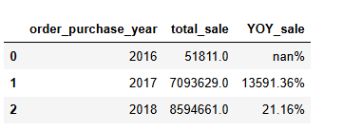
Advanced Problem
Ques-
Calculate the year-over-year growth rate of total sales.
select
yearly_order,yearly_sale,
concat(round((yearly_sale-lag(yearly_sale) over(order by yearly_order))/lag(yearly_sale) over(order by yearly_order)*100,2),'%') as yoy_growth_percent
from(select yearly_order,sum(total_sale) as yearly_sale
from (select year(order_purchase_date) as yearly_order, ov.total_value as total_sale
from orders ot
join order_value ov on ot.order_id=ov.order_id
group by yearly_order, ot.order_id, ov.total_value) as base
group by yearly_order) as base
year_sale=order_merge_py_c.groupby('order_purchase_year')['total_value'].sum().reset_index(name='total_sale’)
year_sale['YOY_sale']=year_sale['total_sale'].pct_change() * 100
year_sale['YOY_sale']=year_sale['YOY_sale'].round(2).astype(str)+"%“

Slide 18
Advanced Problem
Ques-
Calculate the retention rate of customers, defined as the percentage of customers who make another purchase within 6 months of their first purchase.
Ans- 1.6307

Slide 19
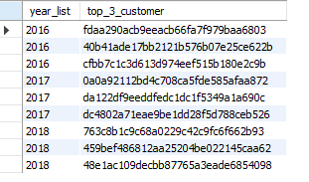
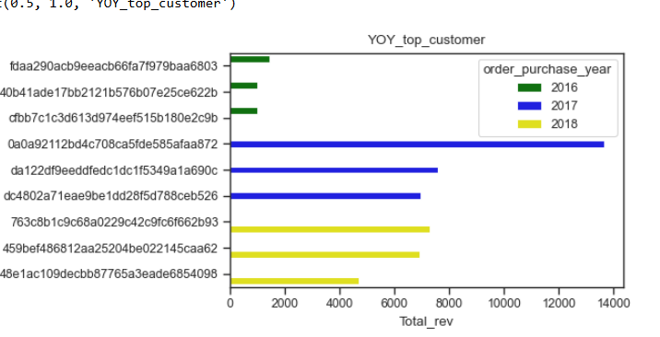
Advanced Problem
Ques-
Identify the top 3 customers who spent the most money in each year.
WITH first_purchase AS
( SELECT c.customer_unique_id, MIN(o.order_purchase_date) AS first_purchase_date
FROM orders o
JOIN customers c ON o.customer_id = c.customer_id
WHERE o.order_status
NOT IN ('canceled','unavailable')
GROUP BY c.customer_unique_id),retained_customers AS
( SELECT DISTINCT fp.customer_unique_id
FROM first_purchase fp
JOIN orders o ON o.order_purchase_date > fp.first_purchase_date AND o.order_purchase_date <= DATE_ADD(fp.first_purchase_date, INTERVAL 180 DAY)
JOIN customers c ON o.customer_id = c.customer_id AND c.customer_unique_id = fp.customer_unique_id
WHERE o.order_status
NOT IN ('canceled','unavailable'))SELECT (COUNT(*)/(select count(distinct customer_unique_id)
from customers))*100 AS retained_customers
FROM retained_customers;
plt.figure(figsize=(5,3))
sns.barplot(data=YOY_top_customer,x='Total_rev',y='customer_unique_id',hue='order_purchase_year',palette=['green','blue','yellow'])
plt.title('YOY_top_customer')

Slide 20
INSIGHTS
Sales Analysis
Approx 52% of total orders were made using installment payment method
The demand for number of orders in each month of 2018 are almost stagnant. There is no such a simple growth rate, peak or decline season.
Padre Carvalto is a city recorded highest average order value per transaction indicates strnonger purchasing power.
Moving averages show stable purchasing behavior with gradual increase over time.
Customer Background
There is abnormal distribution of customer toward different states
Approximately 86% of customers resides in the SP state.
Customer Retention rate is only 1.6% over the six month time period shows the low customer engagement and loyalty.
More than half of the customer prefer flexible payment option during the online purchase shows the low income and goods purchasing capacity of customers.
Health and Beauty category is a fastest growing category and contributed 9.1% of total revenue, indicating strong and increasing customer demand within this sector.
Analysis reveals customers spread across numerous unique cities throughout World, indicating widespread market penetration and diverse geographical reach.

Slide 21
Conclusion
Overall, the analysis shows that the online store has steady order demand with no major seasonal changes during the year. Most customers prefer installment payments, which shows the importance of flexible payment options. A large number of customers are from the SP state, but orders are still coming from many different cities, showing that the store has a wide reach. The Health and Beauty category is growing fast and contributing a good share of revenue. However, the customer retention rate is very low, which means the business needs to focus more on keeping customers engaged so they come back and purchase again.

